Slide 1
SENTIMENT ANALYSIS WITH BERT: LAYER FREEZING, PROBABILITY CALIBRATION, AND ORDINAL RATING MAPPING
Instructor: Dr. Jesus Gonzalez
Members:
Bijay Bastakoti
Binamra Aryal
Navjot Gill
Notes:
AI-generated content may be incorrect. ---

Slide 2
PREPROCESSING
Notes:
--- This slide references information from the following file: https://mavsuta-my.sharepoint.com/personal/bxa7604_mavs_uta_edu/_layouts/15/Doc.aspx?sourcedoc=%7B05F721C6-A067-43CF-8748-D99AB4192200%7D&file=Technical%20Documentation.docx&action=default&mobileredirect=true,https://mavsuta-my.sharepoint.com/personal/bxa7604_mavs_uta_edu/_layouts/15/Doc.aspx?sourcedoc=%7BF4E41F29-EC7D-4B91-86C4-2D579247E225%7D&file=Report%20Submission%202.docx&action=default&mobileredirect=true Project Overview

Slide 3

PROJECT OVERVIEW
Dataset Composition
The dataset contains 50,000 labeled movie reviews split evenly between positive and negative sentiments across training and testing sets.
Preprocessing Approach
Preprocessing focuses on raw review texts to control feature representation and data cleaning for model training.
Model Training Foundation
Accurate sentiment classification is enabled by retaining all relevant linguistic features during preprocessing for CNN and BERT models.
Notes:
--- This slide references information from the following file: https://mavsuta-my.sharepoint.com/personal/bxa7604_mavs_uta_edu/_layouts/15/Doc.aspx?sourcedoc=%7B05F721C6-A067-43CF-8748-D99AB4192200%7D&file=Technical%20Documentation.docx&action=default&mobileredirect=true,https://mavsuta-my.sharepoint.com/personal/bxa7604_mavs_uta_edu/_layouts/15/Doc.aspx?sourcedoc=%7BF4E41F29-EC7D-4B91-86C4-2D579247E225%7D&file=Report%20Submission%202.docx&action=default&mobileredirect=true The goal of this project is to prepare the IMDb dataset for sentiment analysis using CNN and BERT models. The raw dataset, known as aclImdb, consists of 50,000 labeled movie reviews evenly split between positive and negative sentiments. These reviews are organized into training and testing sets, each containing 25,000 reviews. The dataset also includes 50,000 unlabeled reviews and additional resources such as pre-computed vocabulary lists. However, our preprocessing pipeline focuses exclusively on the raw review texts to maintain full control over the feature representation and cleaning stages. This approach ensures that the sentiment analysis models are trained on data that retains all relevant linguistic features, providing a robust foundation for accurate sentiment classification.

Slide 4
DATASET DETAILS
Notes:
--- This slide references information from the following file: https://mavsuta-my.sharepoint.com/personal/bxa7604_mavs_uta_edu/_layouts/15/Doc.aspx?sourcedoc=%7B05F721C6-A067-43CF-8748-D99AB4192200%7D&file=Technical%20Documentation.docx&action=default&mobileredirect=true,https://mavsuta-my.sharepoint.com/personal/bxa7604_mavs_uta_edu/_layouts/15/Doc.aspx?sourcedoc=%7BF4E41F29-EC7D-4B91-86C4-2D579247E225%7D&file=Report%20Submission%202.docx&action=default&mobileredirect=true Dataset Structure

Slide 5
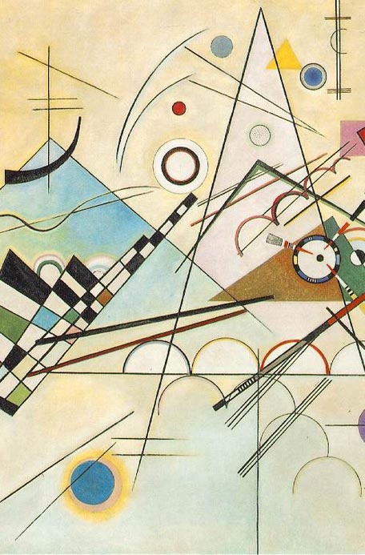
DATASET STRUCTURE
Folder Organization
The dataset is organized into root directory with separate training and testing folders divided into 'pos' and 'neg' subfolders.
File Naming Convention
Review files are named using {id}_{rating}.txt format, embedding sentiment labels via IMDb star ratings from 1 to 10.
Sentiment Labeling
Ratings of 7 or higher mark positive reviews, while 4 or lower indicate negative, simplifying labeling through file organization.
Additional Dataset Files
Files like imdb.vocab and labeledBow.feat provide vocabulary and features but were not used to maintain preprocessing control.
This Photo by Unknown Author is licensed under CC BY-NC-ND
Notes:
--- This slide references information from the following file: https://mavsuta-my.sharepoint.com/personal/bxa7604_mavs_uta_edu/_layouts/15/Doc.aspx?sourcedoc=%7B05F721C6-A067-43CF-8748-D99AB4192200%7D&file=Technical%20Documentation.docx&action=default&mobileredirect=true,https://mavsuta-my.sharepoint.com/personal/bxa7604_mavs_uta_edu/_layouts/15/Doc.aspx?sourcedoc=%7BF4E41F29-EC7D-4B91-86C4-2D579247E225%7D&file=Report%20Submission%202.docx&action=default&mobileredirect=true The aclImdb dataset is structured into a root directory containing separate folders for training and testing data. Each of these folders is further divided into 'pos' and 'neg' subfolders, which contain plain-text reviews labeled as positive or negative. The naming convention of the review files follows the format {id}_{rating}.txt, where 'id' is a unique identifier and 'rating' is the IMDb star rating from 1 to 10. Ratings of 7 or higher are considered positive, while ratings of 4 or lower are considered negative. This structure embeds sentiment labels directly into the file organization and naming, simplifying the data loading and labeling process. Additional files such as imdb.vocab and labeledBow.feat provide vocabulary and pre-processed features, but were not used in our pipeline to retain control over preprocessing.

Slide 6
PREPROCESSING STRATEGY
Notes:
--- This slide references information from the following file: https://mavsuta-my.sharepoint.com/personal/bxa7604_mavs_uta_edu/_layouts/15/Doc.aspx?sourcedoc=%7BF4E41F29-EC7D-4B91-86C4-2D579247E225%7D&file=Report%20Submission%202.docx&action=default&mobileredirect=true,https://mavsuta-my.sharepoint.com/personal/bxa7604_mavs_uta_edu/_layouts/15/Doc.aspx?sourcedoc=%7B31593F4C-7955-4F1F-B70A-316AD8784EDB%7D&file=Dataset_Info.docx&action=default&mobileredirect=true Preprocessing Philosophy

Slide 7

PREPROCESSING PHILOSOPHY
Retention of Critical Stop Words
Stop words like 'not' and 'but' are retained to preserve essential sentiment and negation in the text.
Avoidance of Stemming and Lemmatization
Stemming and lemmatization were avoided to maintain nuanced meanings of different word forms in the data.
Preservation of Sentiment Punctuation
Punctuation like exclamation and question marks is preserved and isolated as strong sentiment indicators.
Minimal Cleaning for Linguistic Richness
Noise and technical artifacts are removed while preserving the linguistic richness for effective model learning.
Notes:
--- This slide references information from the following file: https://mavsuta-my.sharepoint.com/personal/bxa7604_mavs_uta_edu/_layouts/15/Doc.aspx?sourcedoc=%7BF4E41F29-EC7D-4B91-86C4-2D579247E225%7D&file=Report%20Submission%202.docx&action=default&mobileredirect=true,https://mavsuta-my.sharepoint.com/personal/bxa7604_mavs_uta_edu/_layouts/15/Doc.aspx?sourcedoc=%7B31593F4C-7955-4F1F-B70A-316AD8784EDB%7D&file=Dataset_Info.docx&action=default&mobileredirect=true Our preprocessing strategy is guided by the principle of minimal but essential cleaning. We deliberately chose to retain stop words such as 'not' and 'but' because they are critical for expressing sentiment and negation. Similarly, we avoided stemming and lemmatization to preserve the nuanced meanings of different word forms. Punctuation marks like exclamation points and question marks were preserved and isolated to serve as strong sentiment indicators. The goal was to remove technical artifacts and noise while maintaining the linguistic richness of the original reviews. This conservative approach ensures that the models can learn from the full spectrum of sentimental expression present in the dataset.

Slide 8
PREPROCESSING PIPELINE
Notes:
--- This slide references information from the following file: https://mavsuta-my.sharepoint.com/personal/bxa7604_mavs_uta_edu/_layouts/15/Doc.aspx?sourcedoc=%7BF4E41F29-EC7D-4B91-86C4-2D579247E225%7D&file=Report%20Submission%202.docx&action=default&mobileredirect=true,https://mavsuta-my.sharepoint.com/personal/bxa7604_mavs_uta_edu/_layouts/15/Doc.aspx?sourcedoc=%7B31593F4C-7955-4F1F-B70A-316AD8784EDB%7D&file=Dataset_Info.docx&action=default&mobileredirect=true Pipeline Workflow

Slide 9

PIPELINE WORKFLOW
Data Loading Phase
Raw review files are read and structured into a master DataFrame with text, sentiment, and ratings.
Text Cleaning Phase
Text is cleaned by removing HTML tags, lowering case, expanding contractions, isolating punctuation and emoticons, and removing URLs and non-ASCII characters.
Data Partitioning Phase
Cleaned data is split into training, validation, and test sets for robust model development.
Notes:
--- This slide references information from the following file: https://mavsuta-my.sharepoint.com/personal/bxa7604_mavs_uta_edu/_layouts/15/Doc.aspx?sourcedoc=%7BF4E41F29-EC7D-4B91-86C4-2D579247E225%7D&file=Report%20Submission%202.docx&action=default&mobileredirect=true,https://mavsuta-my.sharepoint.com/personal/bxa7604_mavs_uta_edu/_layouts/15/Doc.aspx?sourcedoc=%7B31593F4C-7955-4F1F-B70A-316AD8784EDB%7D&file=Dataset_Info.docx&action=default&mobileredirect=true The preprocessing pipeline consists of three main phases: data loading, text cleaning, and data partitioning. In the data loading phase, raw review files are read from the aclImdb directory and structured into a master DataFrame containing review text, sentiment label, and star rating. The text cleaning phase involves removing HTML tags, converting text to lowercase, expanding contractions, isolating punctuation and emoticons, and removing URLs and non-ASCII characters. Finally, the data is partitioned into training, validation, and test sets. This structured workflow ensures that the data is clean, standardized, and ready for model-specific tokenization and training.

Slide 10
CLEANING TECHNIQUES
Notes:
--- This slide references information from the following file: https://mavsuta-my.sharepoint.com/personal/bxa7604_mavs_uta_edu/_layouts/15/Doc.aspx?sourcedoc=%7BF4E41F29-EC7D-4B91-86C4-2D579247E225%7D&file=Report%20Submission%202.docx&action=default&mobileredirect=true,https://mavsuta-my.sharepoint.com/personal/bxa7604_mavs_uta_edu/_layouts/15/Doc.aspx?sourcedoc=%7B31593F4C-7955-4F1F-B70A-316AD8784EDB%7D&file=Dataset_Info.docx&action=default&mobileredirect=true Key Cleaning Steps

Slide 11

KEY CLEANING STEPS
Removing HTML Tags
Remove HTML tags like to clean web scraping artifacts from the review text.
Converting to Lowercase
Convert all text to lowercase to standardize vocabulary for consistent processing.
Expanding Contractions
Expand contractions such as 'don't' to 'do not' for clearer and more uniform text.
Isolating Punctuation and Emoticons
Add spaces around punctuation and emoticons to treat them as separate tokens during analysis.
Removing URLs and Extra Spaces
Remove URLs and collapse multiple spaces to eliminate noise from the text data.
Notes:
--- This slide references information from the following file: https://mavsuta-my.sharepoint.com/personal/bxa7604_mavs_uta_edu/_layouts/15/Doc.aspx?sourcedoc=%7BF4E41F29-EC7D-4B91-86C4-2D579247E225%7D&file=Report%20Submission%202.docx&action=default&mobileredirect=true,https://mavsuta-my.sharepoint.com/personal/bxa7604_mavs_uta_edu/_layouts/15/Doc.aspx?sourcedoc=%7B31593F4C-7955-4F1F-B70A-316AD8784EDB%7D&file=Dataset_Info.docx&action=default&mobileredirect=true The key cleaning steps applied to the review text include: 1) Removing HTML tags such as <br /> which are artifacts from web scraping; 2) Converting all text to lowercase to standardize vocabulary; 3) Expanding common contractions to their full forms (e.g., 'don't' to 'do not'); 4) Isolating punctuation and emoticons by adding spaces around them to treat them as separate tokens; and 5) Removing URLs and collapsing multiple spaces to eliminate noise. These steps are executed in a specific order to ensure consistency and effectiveness in preparing the text for tokenization and model training.

Slide 12
DATA PARTITIONING
Notes:
--- This slide references information from the following file: https://mavsuta-my.sharepoint.com/personal/bxa7604_mavs_uta_edu/_layouts/15/Doc.aspx?sourcedoc=%7BF4E41F29-EC7D-4B91-86C4-2D579247E225%7D&file=Report%20Submission%202.docx&action=default&mobileredirect=true,https://mavsuta-my.sharepoint.com/personal/bxa7604_mavs_uta_edu/_layouts/15/Doc.aspx?sourcedoc=%7B31593F4C-7955-4F1F-B70A-316AD8784EDB%7D&file=Dataset_Info.docx&action=default&mobileredirect=true Partitioning Strategy

Slide 13
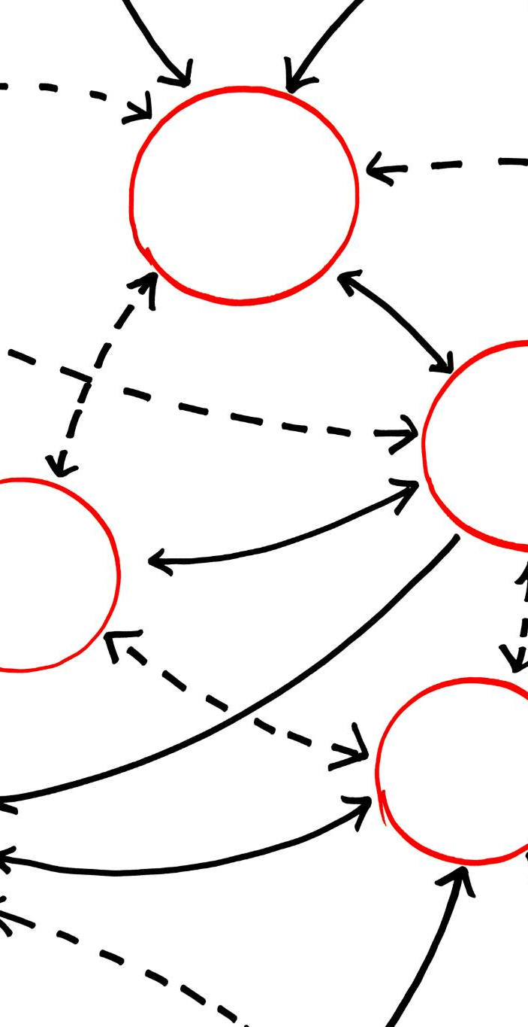
PARTITIONING STRATEGY
Original Dataset Split
The test set of 25,000 reviews is held out strictly to avoid data leakage during model evaluation.
Training and Validation Split
Training data is split 90/10 stratified to maintain class distribution for validation and model tuning.
Reproducible Partitioning
A fixed random seed ensures reproducibility of the training, validation, and test splits.
Notes:
--- This slide references information from the following file: https://mavsuta-my.sharepoint.com/personal/bxa7604_mavs_uta_edu/_layouts/15/Doc.aspx?sourcedoc=%7BF4E41F29-EC7D-4B91-86C4-2D579247E225%7D&file=Report%20Submission%202.docx&action=default&mobileredirect=true,https://mavsuta-my.sharepoint.com/personal/bxa7604_mavs_uta_edu/_layouts/15/Doc.aspx?sourcedoc=%7B31593F4C-7955-4F1F-B70A-316AD8784EDB%7D&file=Dataset_Info.docx&action=default&mobileredirect=true The data partitioning strategy adheres strictly to the original dataset split to prevent data leakage. The 25,000 reviews in the test directory are used as the final held-out test set. The training data is further split using a stratified 90/10 ratio to create a validation set, ensuring that both the training and validation sets maintain the same class distribution. This results in 22,500 reviews for training, 2,500 for validation, and 25,000 for testing. A fixed random seed is used to make the split reproducible. This partitioning is crucial for robust model evaluation and hyperparameter tuning.

Slide 14
PIPELINE ARCHITECTURE
Notes:
--- This slide references information from the following file: https://mavsuta-my.sharepoint.com/personal/bxa7604_mavs_uta_edu/_layouts/15/Doc.aspx?sourcedoc=%7B05F721C6-A067-43CF-8748-D99AB4192200%7D&file=Technical%20Documentation.docx&action=default&mobileredirect=true Software Design and Modules

Slide 15
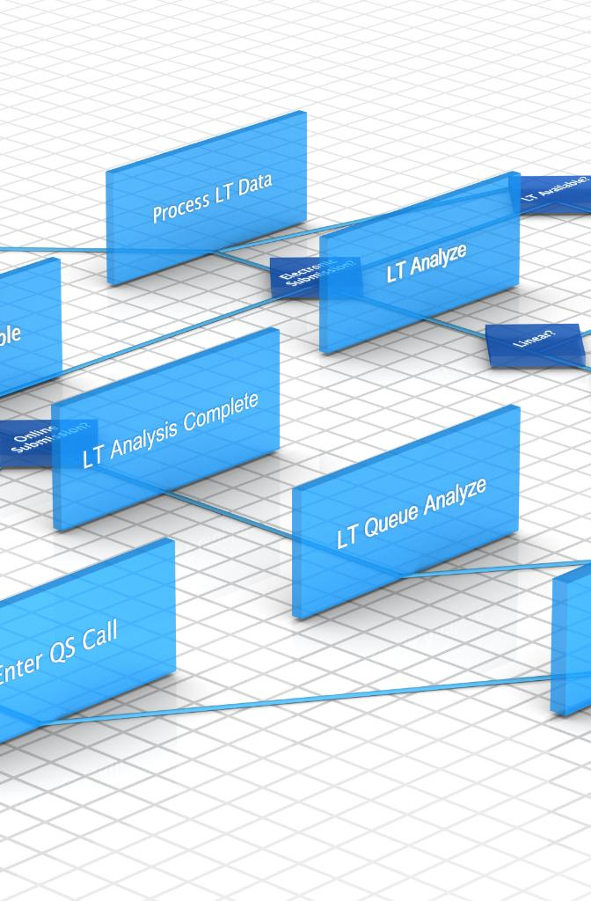
SOFTWARE DESIGN AND MODULES
Modular Python Architecture
The pipeline is structured as modular Python packages separating preprocessing and resources for clear functionality.
Design Patterns Usage
Strategy Pattern enables flexible text cleaning steps; Facade Pattern manages overall workflow orchestration.
Pipeline Operation Coordination
Preprocessing Pipeline class coordinates loading, cleaning, partitioning, and saving data sequentially.
Notes:
--- This slide references information from the following file: https://mavsuta-my.sharepoint.com/personal/bxa7604_mavs_uta_edu/_layouts/15/Doc.aspx?sourcedoc=%7B05F721C6-A067-43CF-8748-D99AB4192200%7D&file=Technical%20Documentation.docx&action=default&mobileredirect=true The preprocessing pipeline is implemented using a modular Python architecture. The main application directory, Data Preprocessor/, contains two primary packages: preprocess and resources, along with an execution script main.py. The preprocess package includes modules for data loading, partitioning, and text cleaning, each encapsulated in its own class. The resources package holds static data like contraction mappings. The pipeline uses the Strategy Pattern for text cleaning, allowing flexible composition of cleaning steps, and the Facade Pattern for orchestrating the entire workflow. The PreprocessingPipeline class coordinates all components and executes the sequence of operations: loading, cleaning, partitioning, and saving the final datasets.

Slide 16
FINAL OUTPUT
Notes:
--- This slide references information from the following file: https://mavsuta-my.sharepoint.com/personal/bxa7604_mavs_uta_edu/_layouts/15/Doc.aspx?sourcedoc=%7B31593F4C-7955-4F1F-B70A-316AD8784EDB%7D&file=Dataset_Info.docx&action=default&mobileredirect=true,https://mavsuta-my.sharepoint.com/personal/bxa7604_mavs_uta_edu/_layouts/15/Doc.aspx?sourcedoc=%7BF4E41F29-EC7D-4B91-86C4-2D579247E225%7D&file=Report%20Submission%202.docx&action=default&mobileredirect=true Cleaned Datasets

Slide 17

CLEANED DATASETS
Clean CSV Files
Three clean CSV datasets include train, validation, and test files with standardized structures for effective use.
Structured Dataset Content
Each file contains cleaned review text, binary sentiment labels, and original star ratings for detailed analysis.
Tokenizer Compatibility
Datasets are prepared for direct input into tokenizers like WordPiece for BERT and Word2Vec for CNN models.
Foundation for Sentiment Models
Cleaned datasets provide a rigorous base for training, validating, and evaluating sentiment analysis models.
Notes:
--- This slide references information from the following file: https://mavsuta-my.sharepoint.com/personal/bxa7604_mavs_uta_edu/_layouts/15/Doc.aspx?sourcedoc=%7B31593F4C-7955-4F1F-B70A-316AD8784EDB%7D&file=Dataset_Info.docx&action=default&mobileredirect=true,https://mavsuta-my.sharepoint.com/personal/bxa7604_mavs_uta_edu/_layouts/15/Doc.aspx?sourcedoc=%7BF4E41F29-EC7D-4B91-86C4-2D579247E225%7D&file=Report%20Submission%202.docx&action=default&mobileredirect=true The final output of the preprocessing pipeline consists of three clean CSV files: train_clean.csv, validation_clean.csv, and test_clean.csv. Each file contains columns for the cleaned review text, binary sentiment label, and original star rating. These datasets are structured and standardized, making them suitable for direct input into model-specific tokenizers such as WordPiece for BERT or Word2Vec for CNN models. This output provides a scientifically rigorous foundation for training, validating, and evaluating sentiment analysis models.

Slide 18
APPLICATION AND FUTURE USE
Notes:
--- This slide references information from the following file: https://mavsuta-my.sharepoint.com/personal/bxa7604_mavs_uta_edu/_layouts/15/Doc.aspx?sourcedoc=%7B31593F4C-7955-4F1F-B70A-316AD8784EDB%7D&file=Dataset_Info.docx&action=default&mobileredirect=true,https://mavsuta-my.sharepoint.com/personal/bxa7604_mavs_uta_edu/_layouts/15/Doc.aspx?sourcedoc=%7BF4E41F29-EC7D-4B91-86C4-2D579247E225%7D&file=Report%20Submission%202.docx&action=default&mobileredirect=true Model Integration and Evaluation

Slide 19
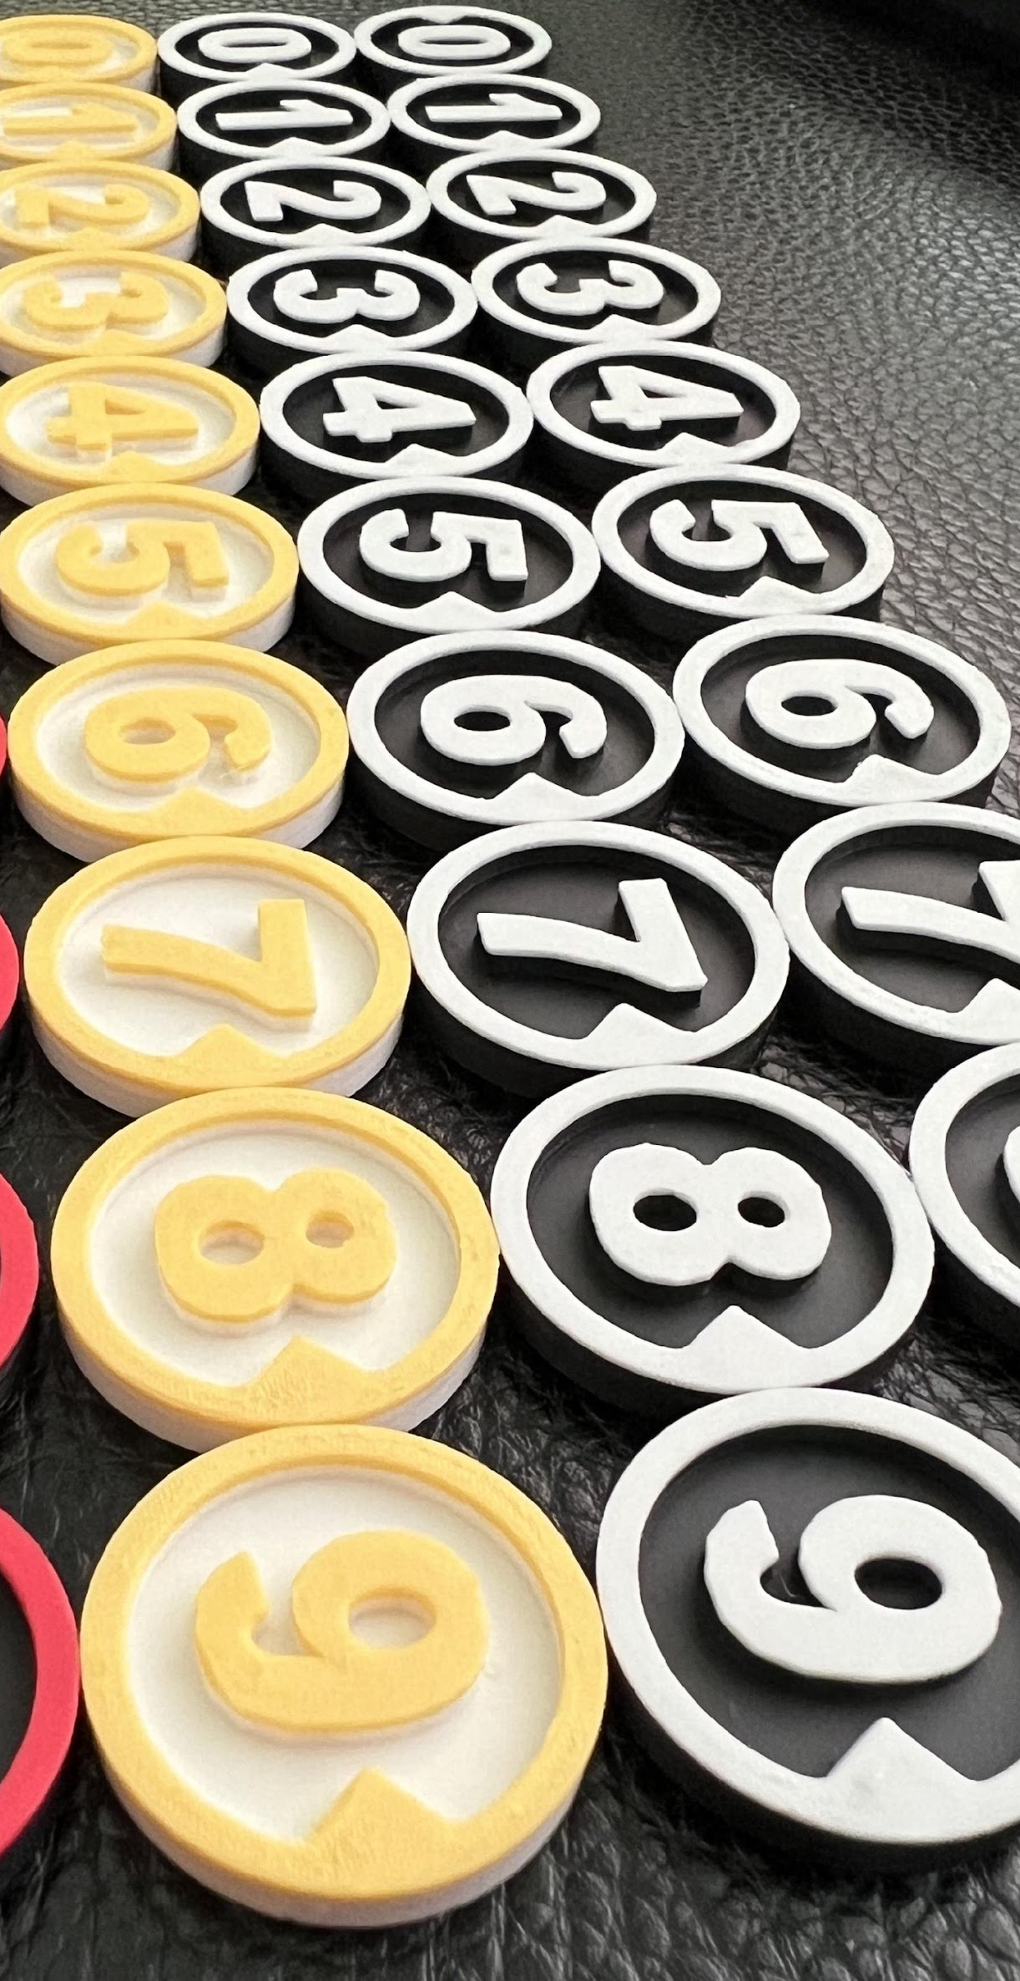
TOKENIZATION AND EMBEDDING STRATEGIES
Keras Tokenizer (Kim CNN)
Transforms raw text into sequences of integer indices based on a fixed vocabulary
Word2Vec Static Embeddings (Kim CNN)
Maps each word to a fixed pre-trained vector that captures semantic similarity, but the representation remains the same regardless of the word’s context in a sentence.
BERT Tokenizer (BERT-base-uncased)
Uses subword tokenization (WordPiece) to break words into smaller units, allowing the model to handle rare or unseen words efficiently.
WordPiece Contextual Embeddings (BERT-based-uncased)
Generates dynamic embeddings where the same word can have different vector representations depending on its surrounding context.
Notes:
--- This slide references information from the following file: https://mavsuta-my.sharepoint.com/personal/bxa7604_mavs_uta_edu/_layouts/15/Doc.aspx?sourcedoc=%7B31593F4C-7955-4F1F-B70A-316AD8784EDB%7D&file=Dataset_Info.docx&action=default&mobileredirect=true,https://mavsuta-my.sharepoint.com/personal/bxa7604_mavs_uta_edu/_layouts/15/Doc.aspx?sourcedoc=%7BF4E41F29-EC7D-4B91-86C4-2D579247E225%7D&file=Report%20Submission%202.docx&action=default&mobileredirect=true The cleaned datasets are intended for use in training sentiment classification models such as BERT and CNN. The training set will be used to fit the models, the validation set will support hyperparameter tuning, and the test set will provide an unbiased evaluation of model performance. This structured approach ensures that the models are trained on high-quality data and evaluated rigorously, enabling reliable sentiment analysis outcomes. The pipeline's modular design also allows for easy adaptation to other datasets or preprocessing requirements in future projects.

Slide 20
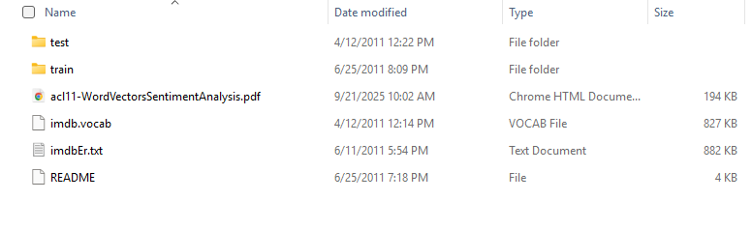
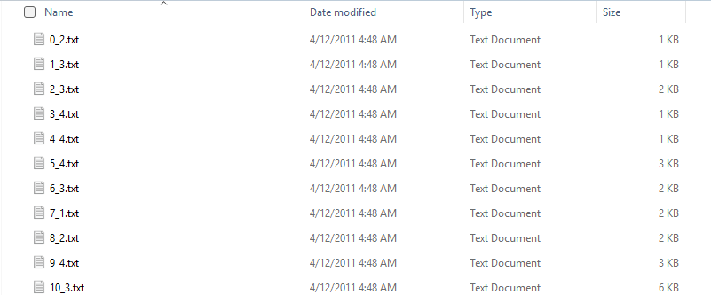
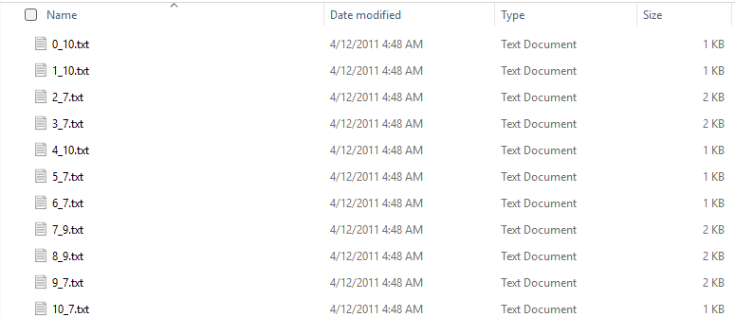

Slide 21
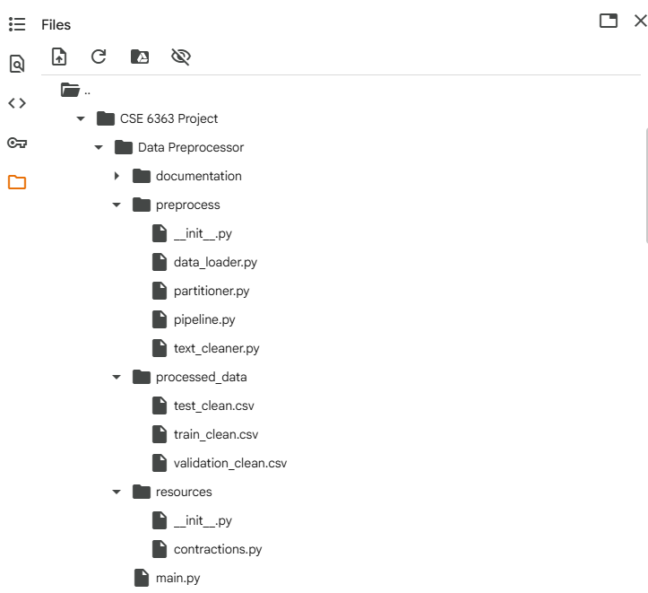

Slide 22
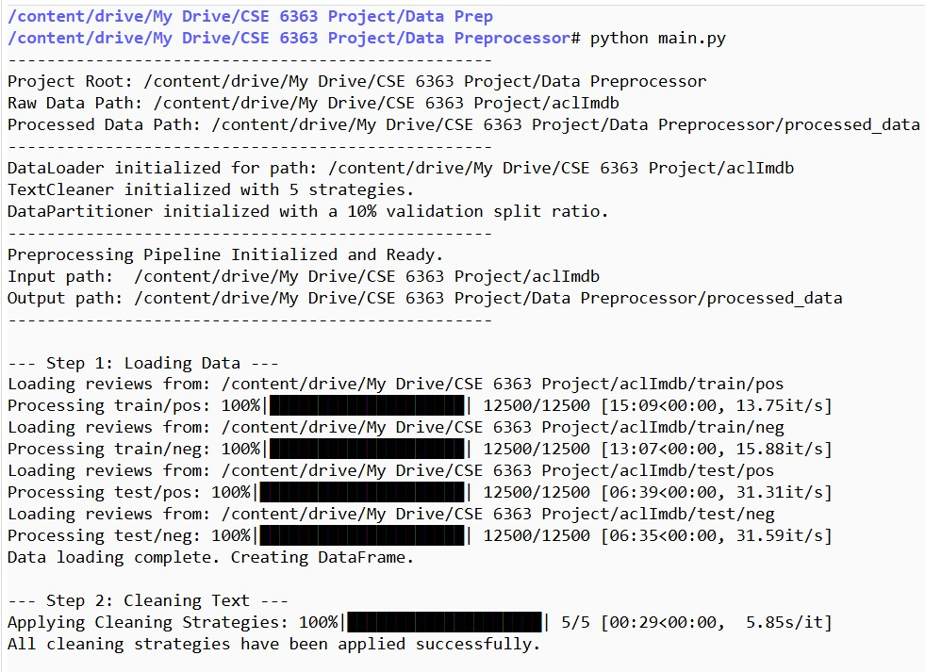

Slide 23
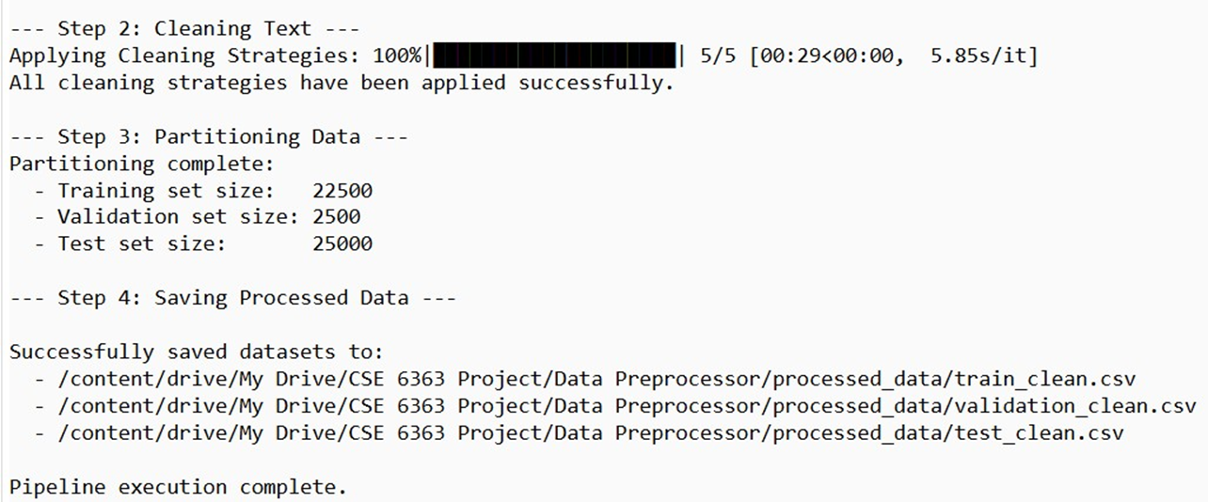

Slide 24
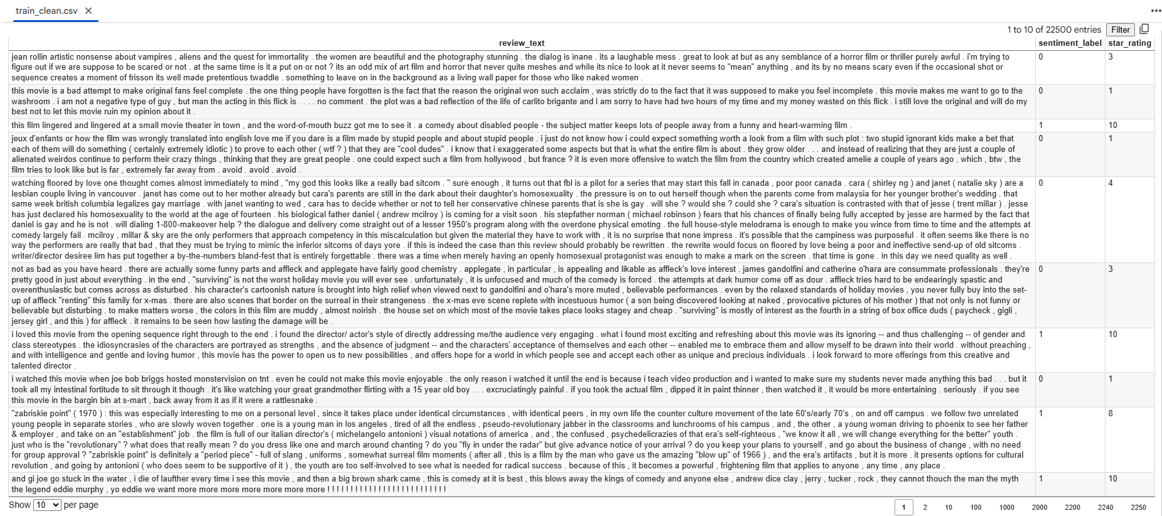

Slide 25
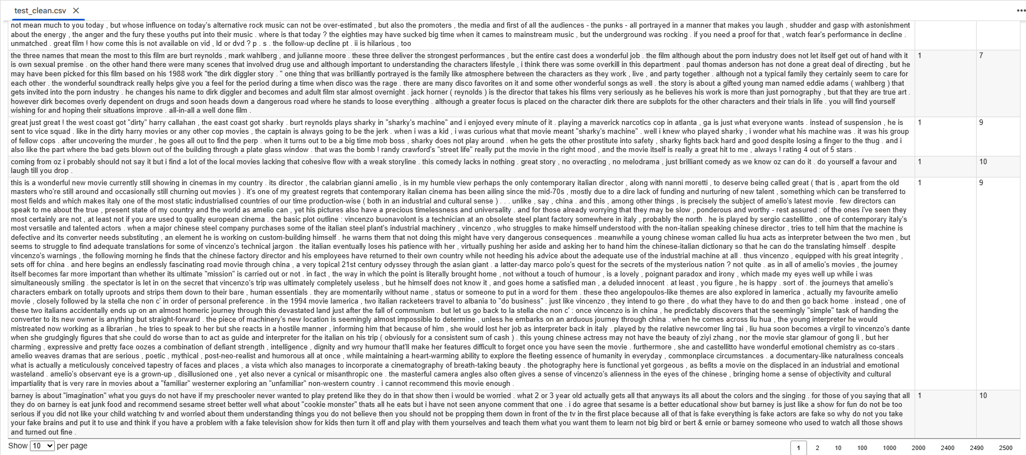

Slide 26
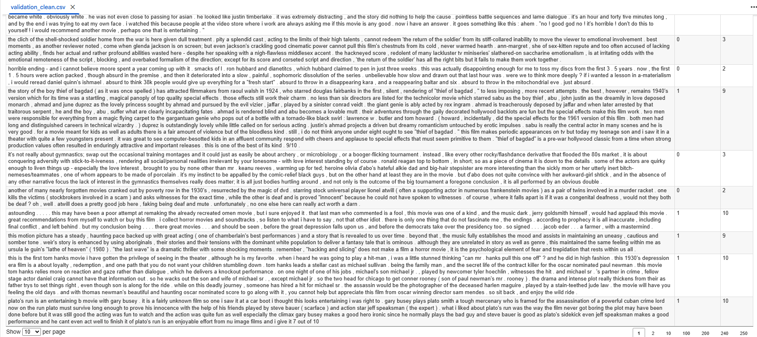

Slide 27
REFERENCE
Maas, A. L., Daly, R. E., Pham, P. T., Huang, D., Ng, A. Y., & Potts, C. (2011). Learning word vectors for sentiment analysis. In Proceedings of the 49th Annual Meeting of the Association for Computational Linguistics: Human Language Technologies (pp. 142–150). Association for Computational Linguistics.

